Slide 1
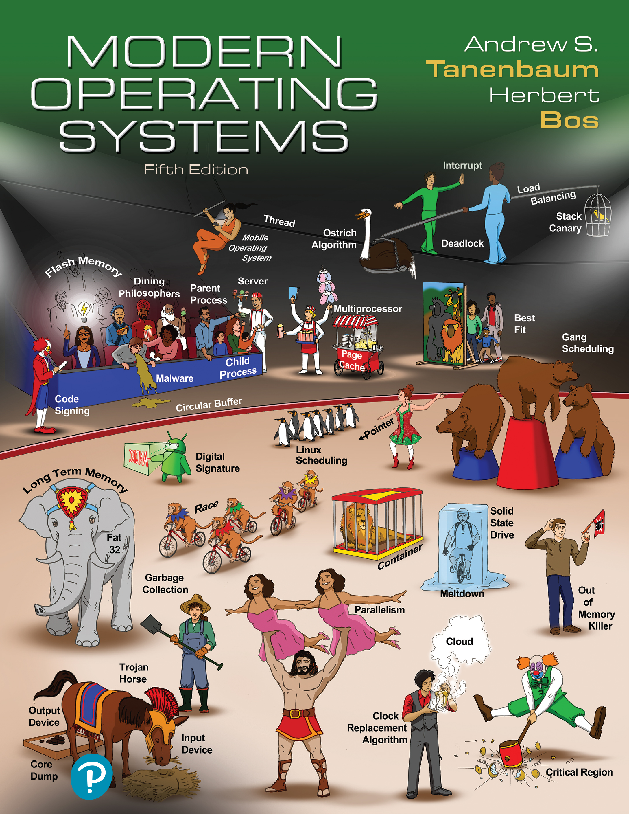

Modern Operating Systems
Fifth Edition
Chapter 2
Threads
Copyright © 2023, 2014, 2008 Pearson Education, Inc. All Rights Reserved
Notes:
If this PowerPoint presentation contains mathematical equations, you may need to check that your computer has the following installed:
1) Math Type Plugin
2) Math Player (free versions available)
3) NVDA Reader (free versions available)

Slide 2
Threads
Implicit assumption so far:
1 process
1 thread of execution
Multithreaded execution:
1 process
N threads of execution
Why allow multiple threads per process?
Lightweight processes
Allow space- and time- efficient parallelism
Organized in thread groups
Allow simple communication and synchronization

Slide 3
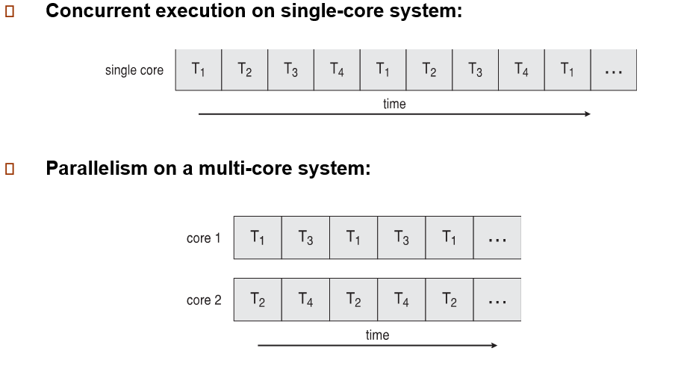
Concurrency vs. Parallelism

Slide 4
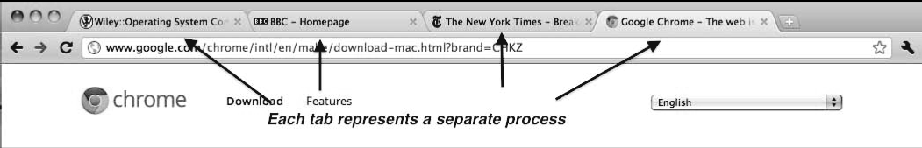
Threads Usage
Many web browsers ran as single process (some still do)
If one web site causes trouble, entire browser can hang or crash
Google Chrome Browser is multiprocess with 3 different types of processes:
Browser process manages user interface, disk and network I/O
Renderer process renders web pages, deals with HTML, Javascript. A new renderer created for each website opened
Runs in sandbox restricting disk and network I/O, minimizing effect of security exploits
Plug-in process for each type of plug-in

Slide 5
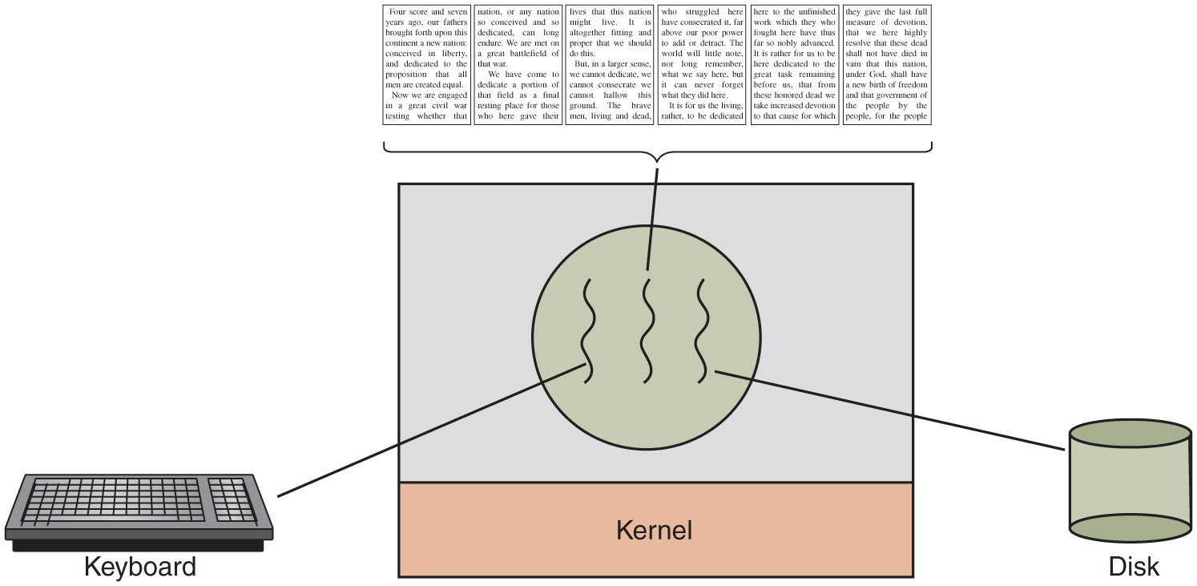
Thread Usage
A word processor with three threads.
Notes:
Long Description:
The image consists of a square block in the center with two horizontal partitions. A circle with three wavy lines is in the first partition and the second partition is labeled kernel. There is a keyboard on the left connected with the first wavy line in the circle and a cylindrical disk on the right connected with the third wavy line of a circle. Six pages of a book are shown on the top of the square and are connected with the center wavy line of a circle. The first page states that "Four score and seven years ago, our fathers brought forth upon this continent a new nation: conceived in liberty, and dedicated to the proposition that all men are created equal. Now we are engaged in a great civil war testing whether that." The second page states that "nation, or any nation so conceived and so dedicated, can long endure. We are met on a great battlefield of that war. We have come to dedicate a portion of that field as a final resting place for those who here gave their." The third page states that "lives that this nation might live. It is altogether fitting and proper that we should do this. But, in a larger sense, we cannot dedicate, we cannot consecrate we cannot hallow this ground. The brave men, living and dead." The fourth page states that "who struggled here have consecrated it, far above our poor power to add or detract. The world will little note, nor long remember, what we say here, but it can never forget what they did here. It is for us the living, rather, to be dedicated." The fifth page states that "here to the unfinished work which they who fought here have thus far so nobly advanced. It is rather for us to be here dedicated to the great task remaining before us, that from these honored dead we take increased devotion to that cause for which." The sixth page states that "they gave the last full measure of devotion, that we here highly resolve that these dead shall not have died in vain that this nation, under God, shall have a new birth of freedom and that government of the people by the people, for the people."

Slide 6
Thread Benefits
Responsiveness – may allow continued execution if part of process is blocked, especially important for user interfaces
Resource Sharing – threads share resources of process, easier than shared memory or message passing
Economy – cheaper than process creation, thread switching lower overhead than context switching
Scalability – process can take advantage of multiprocessor architectures

Slide 7
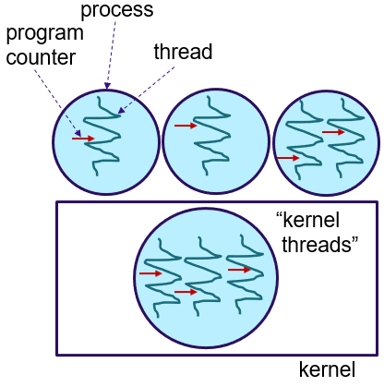
Threads and Processes
Threads reside in the same address space of a single process
All information exchange is via data shared between the threads
Threads synchronize via simple primitives
Each thread has its own stack, hardware registers, and state
Thread table/switch: a lighter process table/switch
Each thread may call any O S-supported system call on behalf of the process to which it belongs
Notes:
Long Description:
The block is labeled as a kernel and the circle inside is labeled the kernel threads. Each circle has lines inside them. The circle on top is labeled process, the lines inside are labeled the thread, and the arrows pointing to the thread are labeled program counter.

Slide 8
Single and Multithreaded Processes

Slide 9
P O S I X Threads
Thread call | Description
P thread_create | Create a new thread
p thread_exit | Terminate the calling thread
p thread_join | Wait for a specific thread to exit
p thread_yield | Release the C P U to let another thread run
p thread_attr_init | Create and initialize a thread's attribute structure
p thread_attr_destroy | Remove a thread's attribute structure
Some of the P threads function calls.

Slide 10
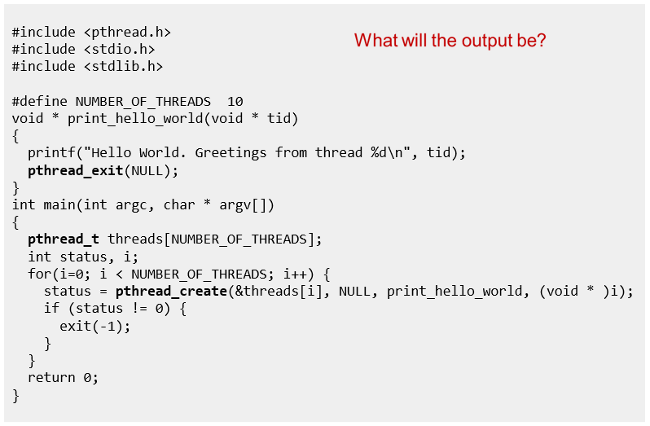
Pthreads Example
Notes:
A: 10x “Hello World. Greetings from thread …” in arbitrary order
Long Description:
The code from top to bottom is as follows.
hashtag include left angle bracket p thread dot h right angle bracket
hashtag include left angle bracket stdio dot h right angle bracket
hashtag include left angle bracket stdlib dot h right angle bracket
hashtag define NUMBER underscore OF underscore THREADS 10
void asterisk print underscore hello underscore world left parenthesis void asterisk t i d right parenthesis
left brace
print f left parenthesis double quote Hello World. Greetings from thread percent d backward slash n double quote comma t i d right parenthesis semi colon
p thread underscore exit left parenthesis NULL right parenthesis semi colon
right brace
int main left parenthesis int arg c comma char asterisk arg v left bracket right bracket right parenthesis
left brace
p thread underscore t threads left bracket NUMBER underscore OF underscore THREADS right bracket semi colon
int status comma i semi colon
for left parenthesis i equal 0 semicolon i left angle bracket NUMBER underscore OF underscore THREADS semicolon i plus plus right parenthesis left brace
status equal p thread underscore create left parenthesis and thread left bracket i right bracket comma NULL comma print underscore hello underscore world comma left parenthesis void asterisk right parenthesis i right parenthesis semi colon
if left parenthesis status exclamation mark equals 0 right parenthesis left brace
exit left parenthesis negative 1 right parenthesis semi colon
right brace
right brace
return 0 semicolon
right brace
What will the output be?

Slide 11
Pthreads Code for Joining 10 Threads

Slide 12
User Threads and Kernel Threads
User threads - management done by user-level threads library
Three primary thread libraries:
POSIX Pthreads
Windows threads
Java threads
Kernel threads - Supported by the Kernel
Examples – virtually all general-purpose operating systems, including:
Windows
Solaris
Linux
Tru64 UNIX
Mac OS X

Slide 13
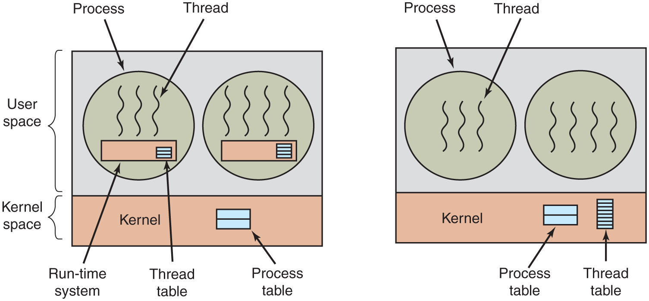
User and Kernel Level Threads
(a) A user-level threads package. (b) A threads package managed by the kernel.
Notes:
Long Description:
The image consists of two parts. Part 1: There is a rectangular block with two horizontal partitions. The first partition is categorized as User-space and the second is kernel space. The top first partition has two circles. The first circle labeled Process has three vertical wavy lines labeled Thread. There is a rectangular block labeled Run time system with another small block labeled Thread table with three partitions. The second circle is the same as the first one, except that there is an extra wavy line in the circle. The second partition is labeled Kernel and a block with two horizontal partitions labeled Process table. Part 2: It is the same as part 1 except that there are no rectangular blocks in both circles. A rectangular block labeled thread table has many partitions is at the lower right end of the kernel space.

Slide 14
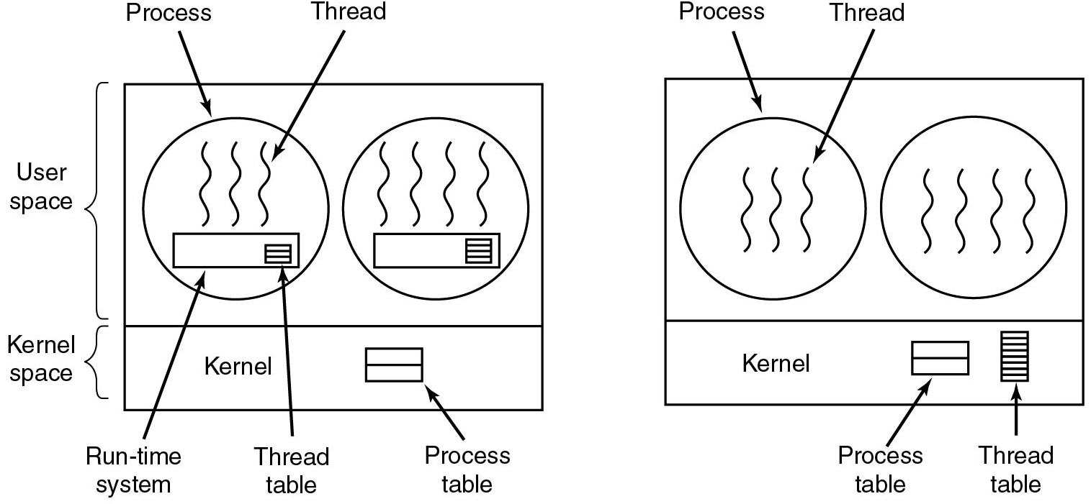
User Threads: Pros and Cons
+ Thread switching time (no mode switch)
+ Scalability, customizability (no in-kernel management)
- Transparency (typically requires app cooperation)
- Parallelism (blocking syscalls are problematic)
Notes:
Long Description:
The image consists of two parts. Part 1: There is a rectangular block with two horizontal partitions. The first partition is categorized as User-space and the second is kernel space. The top first partition has two circles. The first circle labeled Process has three vertical wavy lines labeled Thread. There is a rectangular block labeled Run time system with another small block labeled Thread table with three partitions. The second circle is the same as the first one, except that there is an extra wavy line in the circle. The second partition is labeled Kernel and a block with two horizontal partitions labeled Process table. Part 2: It is the same as part 1 except that there are no rectangular blocks in both circles. A rectangular block labeled thread table has many partitions is at the lower right end of the kernel space.

Slide 15
Multithreading Models
Many-to-One
One-to-One
Many-to-Many

Slide 16
Many-to-One
Many user-level threads mapped to single kernel thread
One thread blocking causes all to block
Multiple threads may not run in parallel on muticore system because only one may be in kernel at a time
Few systems currently use this model
Examples:
Solaris Green Threads
GNU Portable Threads

Slide 17
One-to-One
Each user-level thread maps to kernel thread
Creating a user-level thread creates a kernel thread
More concurrency than many-to-one
Number of threads per process sometimes restricted due to overhead
Examples
Windows
Linux
Solaris 9 and later

Slide 18
Many-to-Many Model
Allows many user level threads to be mapped to many kernel threads
Allows the operating system to create a sufficient number of kernel threads
Solaris prior to version 9
Windows with the ThreadFiber package

Slide 19
Two-level Model
Similar to M:M, except that it allows a user thread to be bound to kernel thread
Examples
IRIX
HP-UX
Tru64 UNIX
Solaris 8 and earlier

Slide 20
Implicit Threading
Growing in popularity as numbers of threads increase, program correctness more difficult with explicit threads
Creation and management of threads done by compilers and run-time libraries rather than programmers
Three methods explored
Thread Pools
OpenMP
Grand Central Dispatch
Other methods include Microsoft Threading Building Blocks (TBB), java.util.concurrent package

Slide 21
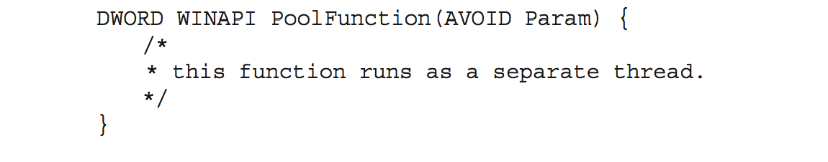
Thread Pools
Create a number of threads in a pool where they await work
Advantages:
Usually slightly faster to service a request with an existing thread than create a new thread
Allows the number of threads in the application(s) to be bound to the size of the pool
Separating task to be performed from mechanics of creating task allows different strategies for running task
i.e.Tasks could be scheduled to run periodically
Windows API supports thread pools:

Slide 22
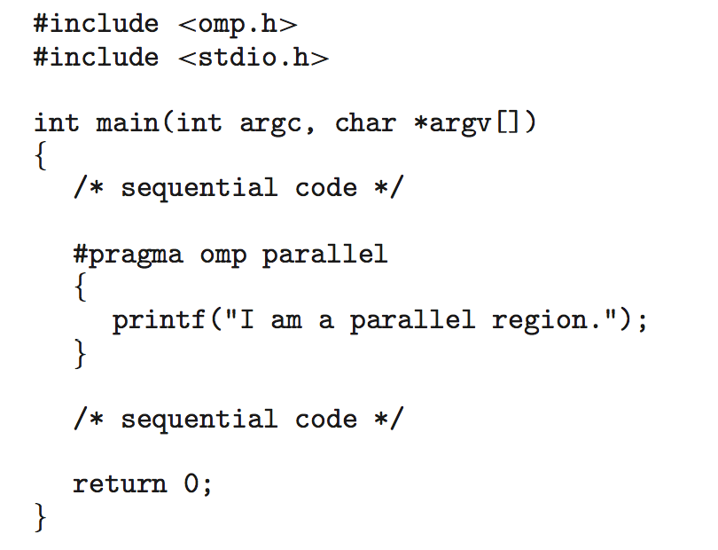
OpenMP
Set of compiler directives and an API for C, C++, FORTRAN
Provides support for parallel programming in shared-memory environments
Identifies parallel regions – blocks of code that can run in parallel
#pragma omp parallel
Create as many threads as there are cores
#pragma omp parallel for for(i=0;i<N;i++) {
c[i] = a[i] + b[i];
}
Run for loop in parallel

Slide 23
Grand Central Dispatch
Apple technology for Mac OS X and iOS operating systems
Extensions to C, C++ languages, API, and run-time library
Allows identification of parallel sections
Manages most of the details of threading
Block is in “^{ }” - ˆ{ printf("I am a block"); }
Blocks placed in dispatch queue
Assigned to available thread in thread pool when removed from queue

Slide 24
Threads: Issues
Does the O S keep track of threads?
Kernel threads versus. user threads
What to do on fork?
Clone all threads versus. calling thread
What if a thread is currently blocking on a systems call?
What to do with signals?
Send signal to all threads versus. single thread
Per-process or per-thread signal handlers
Where to store per-thread variables?
Does sharing come at a cost?
Are threads required inside an operating system?
Notes:
Pthreads on Linux: The child process is created with a single thread—the one that called fork(). Thus: only the calling thread is replicated, not other threads. On other operating systems (e.g. Solaris) you can choose what fork does depending on what library you link to)
The entire virtual address space of the parent is replicated in the child, including the states of mutexes, condition variables, and other pthreads objects; the use of
Signals: Signals are sent to a process, handled by one of the threads
Per-thread variables: T L S (Thread Local Storage)
pthread_atfork(3) may be helpful for dealing with problems that this can cause.

Slide 25
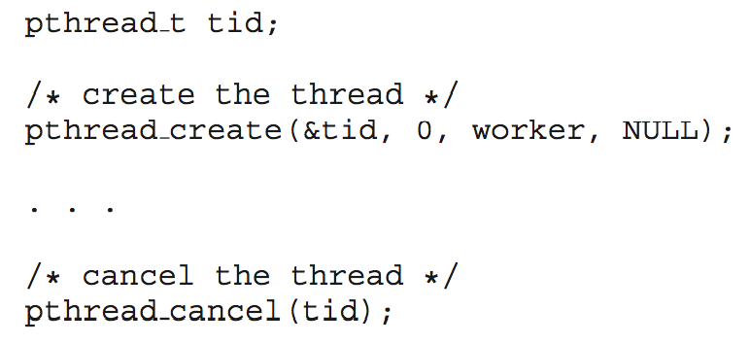
Thread Cancellation
Terminating a thread before it has finished
Thread to be canceled is target thread
Two general approaches:
Asynchronous cancellation terminates the target thread immediately
Deferred cancellation allows the target thread to periodically check if it should be cancelled
Pthread code to create and cancel a thread:

Slide 26
Modern Operating Systems
Fifth Edition
End of Threads Lecture
Copyright © 2023, 2014, 2008 Pearson Education, Inc. All Rights Reserved
Notes:
If this PowerPoint presentation contains mathematical equations, you may need to check that your computer has the following installed:
1) Math Type Plugin
2) Math Player (free versions available)
3) NVDA Reader (free versions available)

